Slide 1
Dynamic Programing - DP
By: Riham Katout

Slide 2
Main approach
DP is a technique that solves some particular type of problems in Polynomial Time. Dynamic Programming solutions are faster than the exponential brute method and can be easily proved their correctness.
The two main approaches to dynamic programming are memorization and tabulation.

Slide 3
Memoization vs. Tabulation
Memoization | Tabulation
Top-down | Bottom-up
Using recursion | Using iteration
Relatively small set of inputs | Large set of inputs
Have overlapping subproblems | Subproblems do not overlap
Recursion is expensive both in processor time and memory space.
In the tabulation approach to DP, we solve all sub-problems and store their results on a matrix. then we continue to solve the larger problems that depend on these computed sub-problems.

Slide 4
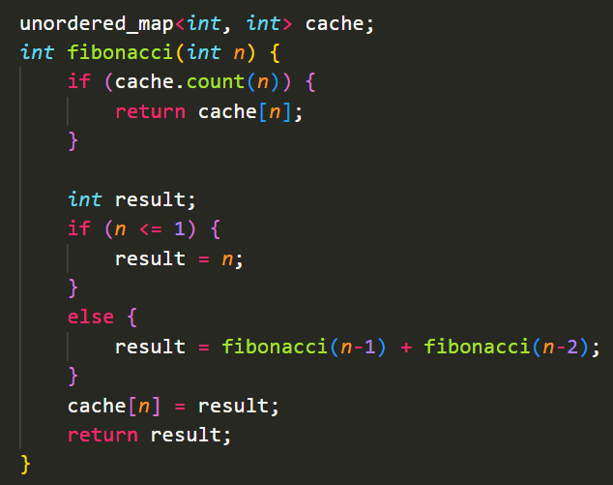
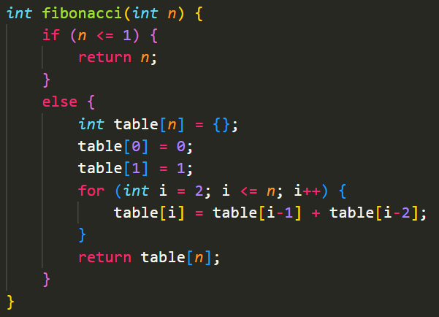
Memoization vs. Tabulation – Fibonacci
Memoization
Tabulation

Slide 5
How to solve a Dynamic Programming Problem ?
First, we need to check two necessary conditions:
Overlapping Subproblems: When the solutions to the same subproblems are needed repetitively for solving the actual problem. The problem is said to have overlapping subproblems property.
Optimal Substructure Property: If the optimal solution of the given problem can be obtained by using optimal solutions of its subproblems then the problem is said to have Optimal Substructure Property.

Slide 6
How to solve a Dynamic Programming Problem ?
Steps to solve a Dynamic programming problem:
Identify if it is a Dynamic programming problem.
Decide a state expression with the Least parameters.
Formulate state and transition relationship.
Do tabulation (or memorization).

Slide 7
Steps to solve a Dynamic programming problem
Step 1: How to classify a problem as a Dynamic Programming Problem?
DP can be applied if the problem can be divided into overlapping subproblems that can be solved independently.
Uses of DP:
Finding an optimal solution
Counting the number of solutions

Slide 8
Steps to solve a Dynamic programming problem
Step 2: Deciding the state
Dynamic Programming problems are all about the state and its transition. This is the most basic step which must be done very carefully because the state transition depends on the choice of state definition you make.
State: A state can be defined as the set of parameters that can uniquely identify a certain position or standing in the given problem. This set of parameters should be as small as possible to reduce state space.

Slide 9
Steps to solve a Dynamic programming problem
Step 3: Formulating a relation among the states
This part is the hardest part of solving a Dynamic Programming problem and requires a lot of intuition, observation, and practice.

Slide 10
Steps to solve a Dynamic programming problem
Step 4: Adding memoization or tabulation for the state
This is the easiest part of a dynamic programming solution. We just need to store the state answer so that the next time that state is required, we can directly use it from our memory.

Slide 11


Slide 12
Dice Combinations
https://cses.fi/problemset/task/1633

Slide 13
Classical DP problems
Coin problem
Longest increasing subsequence
Grid paths
Knapsack problems
Edit distance
Counting tilings

Slide 14
Coin problem (unbounded knapsack)
https://cses.fi/problemset/task/1634

Slide 15
Longest increasing subsequence (LIS)
https://cses.fi/problemset/task/1145

Slide 16
Patience Sorting
Patience sorting is a sorting algorithm based on card game Patience. In this sorting algorithm, the rules of patience game is used to sort an list of elements based on their values.
Rules of Patience Game:
Cards with lower value can be placed over the card.
If there is no possible position for a card, then a new pile can be created.
Goal is to form as much as few piles possible.
1
2
3
4
5
6
7
8
9

Slide 17
6
6
2
3
2
5
1
7
4
8
3
5
1
7
4
8
6
5
7
8
2
4
1
3

Slide 18
Grid Paths Problem
https://cses.fi/problemset/task/1638

Slide 19
Knapsack problems
The knapsack problem can be classified into the following types:
Fractional Knapsack Problem
0/1 Knapsack Problem
Bounded Knapsack Problem
Unbounded Knapsack Problem

Slide 20
Knapsack problems – Fractional Knapsack
Given the weights and values of N items, put these items in a knapsack of capacity W to get the maximum total value in the knapsack. In Fractional Knapsack, we can break items for maximizing the total value of the knapsack.

Slide 21
Knapsack problems – 0/1 Knapsack
We are given N items where each item has some weight (w_{i}) and value (v_{i}) associated with it. We are also given a bag with capacity W. The target is to put the items into the bag such that the sum of values associated with them is the maximum possible.
Note that here we can either put an item completely into the bag or cannot put it at all.

Slide 22
Knapsack problems – 0/1 Knapsack
https://cses.fi/problemset/task/1158
https://cses.fi/problemset/task/1745
https://cses.fi/problemset/task/1093

Slide 23
Knapsack problems – Bounded Knapsack
Given N items, each item having a given weight w_{i} and a value v_{i}, the task is to maximize the value by selecting a maximum of K items adding up to a maximum weight W.

Slide 24
Knapsack problems – Unbounded Knapsack
Given a knapsack weight W and a set of N items with certain value v_{i} and weight w_{i}, we need to calculate the maximum amount that could make up this quantity exactly. This is different from 0/1 Knapsack problem, here we are allowed to use an unlimited number of instances of an item.

Slide 25
Edit distance
https://cses.fi/problemset/task/1639

Slide 26
Counting tilings
https://cses.fi/problemset/task/2181

Slide 27
DP - problems
https://codeforces.com/contest/189/problem/A
https://leetcode.com/problems/climbing-stairs/
https://leetcode.com/problems/fibonacci-number/
https://practice.geeksforgeeks.org/problems/path-in-matrix3805/1
https://leetcode.com/problems/jump-game/
https://codeforces.com/problemset/problem/1851/E **important

